Slide 1
DATA 603 FINAL PROJECT
MOVIE RECOMMENDATION
SYSTEM
CONTRIBUTORS:
DRISHTI ARORA
PARTH SONI
RUSHABH MAHESHKUMAR SHAH

Slide 2
ABSTRACT
IN THIS ERA OF ENTERTAINMENT THE COMPANIES LIKE NETFLIX, AMAZON PRIME ETC. HAVE PROVIDED A HUGE PLATFORM FOR ONLINE STREAMING OF MOVIES, SERIES, DOCUMENTARIES AND OTHER VISUAL ENTERTAINMENT.
THE USERS OF THESE PLATFORMS HAVE ALWAYS BEEN IN A DILEMMA TO CHOOSE WHICH KIND OF MOVIES THEY WOULD LIKE TO WATCH AMONGST THE MILLIONS OF MOVIES UPLOADED BY THESE PLATFORMS.
THAT IS WHERE BIG DATA AND RECOMMENDATIONS HAVE COME IN FOR ANALYZING AND PROVIDING RECOMMENDATIONS USING FILTERING METHODS TO ITS USERS WHICH MAKES IT VERY SIMPLE FOR THESE USERS TO ACCESS THE KIND OF MOVIE ACCORDING TO THE GENRES THEY ARE INTERESTED IN.

Slide 3
INTRODUCTION
STREAMING PLATFORMS LIKE NETFLIX, AMAZON PRIME USES RECOMMENDER SYSTEM TO RECOMMEND MOVIES AND SHOWS TO THE USERS BASED ON THE USER’S WATCHING PATTERNS.
RECOMMENDATION SYSTEM PROVIDES SUGGESTIONS BASED TO THE USER’S THROUGH A FILTERING PROCESS.

Slide 4
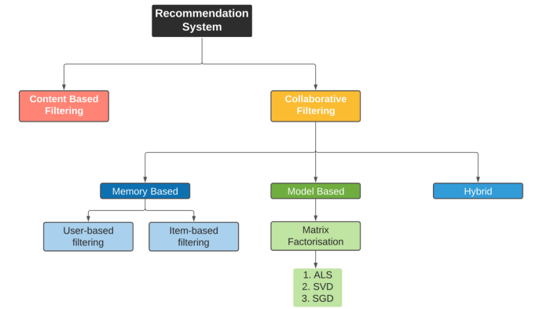
METHODOLOGY

Slide 5
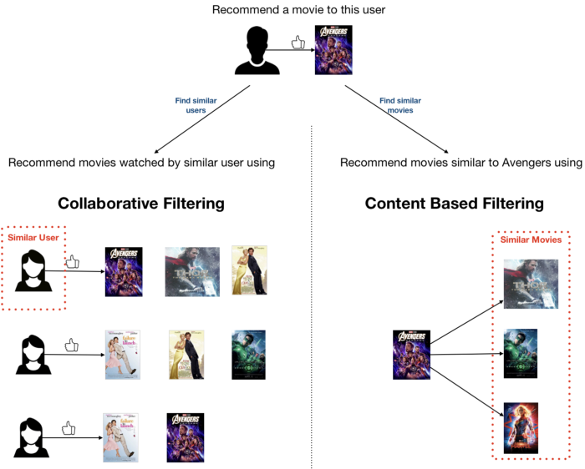

Slide 6
There are two types of Recommendation systems:
Content based filtering: It uses item features to recommend items to the users similar to what they like.
Collaborative filtering: It makes use of other users or other items to predict ratings collaboratively.
In this project, we will work on Collaborative filtering recommendation system to recommend movies to the users based on ratings of each movie.

Slide 7
DATA SUMMARY
THIS PROJECT UTILIZES TWO DISTINCT DATASETS-MOVIES DATASET AND RATINGS DATASET WHICH ARE FOCUSING ON MOVIES, ITS RATINGS AND GENRES.
WE OBTAINED BOTH THE DATASET FROM MOVIE LENS. THE FIRST DATASET CONSISTS OF MOVIEID, TITLE AND GENRE.
THE SECOND DATASET CONSISTS OF MOVIEID, USERID, RATINGS AND TIMESTAMP. IT HAS MORE THAN 1.2 MILLION ROWS.
THE DATA SEEMS TO BE MOSTLY CLEAN WITH LITTLE PREPROCESSING. ALL INSTANCES WITH NULL VALUES AND DUPLICATE VALUES WERE DROPPED. REDUNDANT COLUMN WAS DROPPED IN RATINGS DATASET. YEAR FUNCTION WAS ADDED USING REGEX.

Slide 8
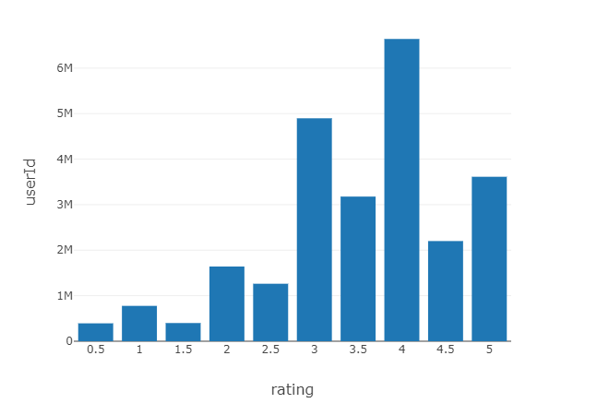
EXPLORATORY DATA ANALYSIS
WE CAN SEE THE DISTRIBUTION OF RATINGS FOR THESE MOVIES THROUGH THIS PLOT .
t

Slide 9
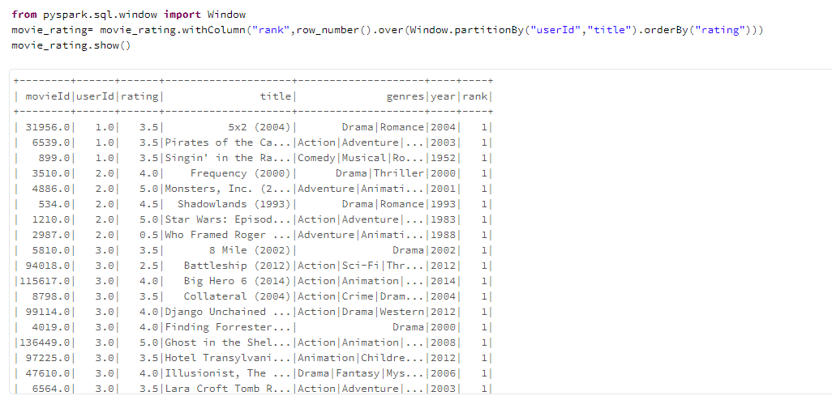
The most viewed movie is the Forrest Gump.
Most movies have the genre Drama.
There are many genres for same movieid and title so we combined the genres and provided ranks to movies for highest ratings provided by each user.

Slide 10
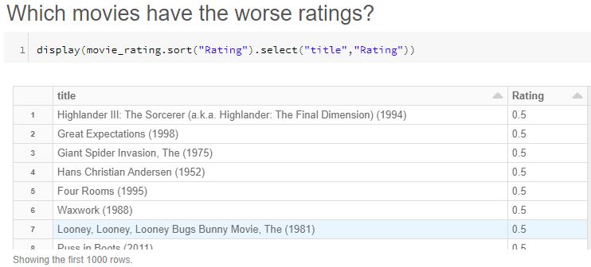
Worst Ratings for different movies that are provided by users are listed in the image below.

Slide 11
RECOMMENDATION USING ALS
ALTERNATING LEAST SQUARES (ALS) MATRIX FACTORIZATION IS USED TO ESTIMATE THE MATRIX R (RATINGS IN THIS CASE) WHICH IS THE PRODUCT OF TWO MATRICES THAT ARE LOWER RANK X AND Y WHERE X * YT = R.
THE METHOD IS ITERATIVE AND IN EACH ITERATION ONE OF THE FACTOR MATRICES IS KEPT CONSTANT AND OTHER IS SOLVED USING LEAST SQUARES. THEN THE NEWLY SOLVED MATRIX IS HELD CONSTANT AND THE OTHER FACTOR MATRIX IS SOLVED.

Slide 12
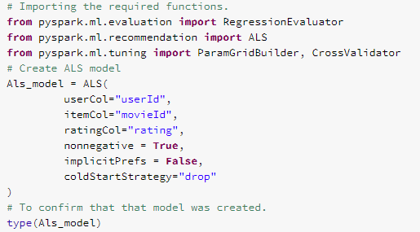
BUILT THE ALS MODEL.
DEFINED THE TUNING PARAMETER USING PARAM_GRID FUNCTION. WE CHOSE 4 PARAMETERS FOR EACH GRID WHICH WILL RESULT IN 16 MODELS FOR TRAINING.

Slide 13
MODEL EVALUATION
DEFINING EVALUATOR WHERE METRIC IS RMSE.
FITTING THE EVALUATOR AND PARAM_GRID FOR ALS MODEL INTO CROSS VALIDATOR. THE NUMBER OF FOLDS WE HAVE CHOSEN IS 2.
WE WILL FIT THE CROSS VALIDATOR TO GIVE THE BEST MODEL PARAMETERS.

Slide 14
RESULT
THE MODEL PERFORMED WITH AN RMSE OF 0.77.

Slide 15
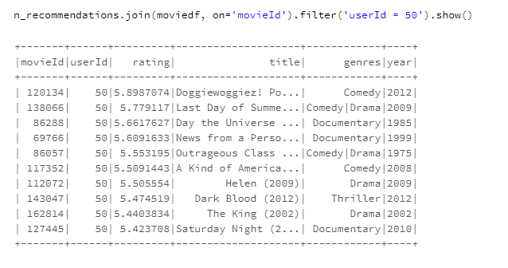
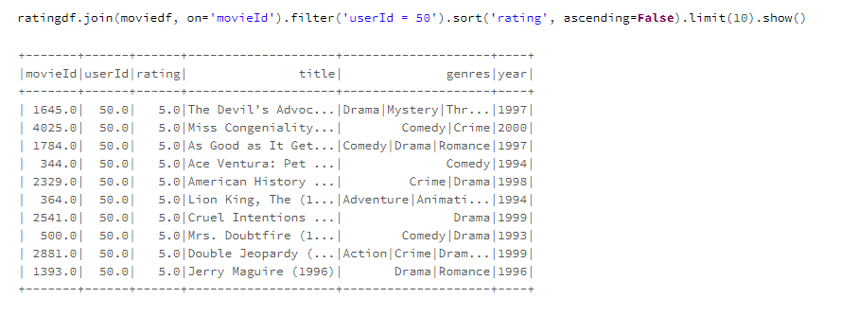
CONCLUSION
THE MOVIES OUR MODEL IS PREDICTING FOR THE HAVE A VERY SIMILAR GENRE COMPARED TO THE MOVIES WATCHED BY THE USER .
WE CAN SEE THAT THE MOVIES WHICH WERE ORIGINALLY VIEWED BY THE 50TH USERID AND THE MOVIES PREDICTED BY THIS MODEL ARE OF THE SIMILAR GENRE WHICH IS WAR, DRAMA ETC.

Slide 16
FUTURE WORK AND LIMITATIONS
IN THIS PROJECT WE HAVE USED SOME PARAM_GRID INPUTS AND 16 MODELS. THERE CAN BE MORE NUMBER OF MODELS THAT CAN BE EXPERIMENTED FOR A BETTER MODEL AND WE CAN SEE DIFFERENT RESULTS THEY DISPLAY.
IN THIS PROJECT WE HAVE ONLY USED ALS WHERE AS THERE ARE SEVERAL OTHER RECOMMENDATION METHODS THAT CAN BE EXPLORED.

Slide 17
REFERENCES
1) HTTPS://GROUPLENS.ORG/DATASETS/MOVIELENS/
2) HTTP://SPARK.APACHE.ORG/DOCS/2.2.0/ML-COLLABORATIVE-FILTERING.HTML
3) HTTPS://WWW.DATA-STATS.COM/SPARK-ANALYTICS-ON-MOVIELENS-DATASET/
4) HTTPS://INTELLIPAAT.COM/COMMUNITY/5161/HOW-DO-I-ADD-A-NEW-COLUMN-TO-A-SPARK-DATAFRAME-USING-PYSPARK
5) HTTPS://EN.WIKIPEDIA.ORG/?TITLE=COLLABORATIVE_FILTERING#/MEDIA/FILE:COLLABORATIVE_FILTERING.GIF
6) HTTPS://GITHUB.COM/SNEHALNAIR/ALS-RECOMMENDER-PYSPARK/BLOB/MASTER/RECOMMENDATION_ENGINE_MOVIELENS.IPYNB
7) HTTPS://DL.ACM.ORG/DOI/10.1109/MC.2009.263
8) HTTPS://FORUMS.DATABRICKS.COM/QUESTIONS/29012/HOW-TO-SHOW-AN-IMAGE-IN-A-NOTEBOOK-USING-HTML.HTML
9) HTTPS://DEVELOPERS.GOOGLE.COM/MACHINE-LEARNING/RECOMMENDATION/COLLABORATIVE/MATRIX

